Slide 1

Project Sunshine
Notes:
Myriam

Slide 2
The Team
Principal Agile Project Manager: Rana Alqrenawi
Frontend : Rachel Chenery & Myriam Thursch
Backend Alun Groome & Rana Alqrenawi
Notes:
Myriam
Alun
Rana
Rachel

Slide 3
Project Sunshine Brief
To develop a web app that can advise on the best time and way to maximise sunshine on your daily walking
Client: Zühlke Manchester
Notes:
Myriam

Slide 4
Sprint Goals
Team Health and Well-being
Tools and Configurations [Github, Eslint,..]
Wireframes
Prototype
Static Frontend
React Frontend [Demo]
Next Sprint
Q & A
Notes:
Myriam
Team Health and Well-being / Rana
Tools and Configurations [Github, Eslint,..] / Alun
Wireframes / Rachel
Prototype / Rachel
Static Frontend / Myriam
React Frontend [Demo] / run it on (Alun) machine
Components and styles [Rachel]
The Pages [each to speak about the page they’ve developed]
Next Sprint [Security, ..]
Q & A

Slide 5
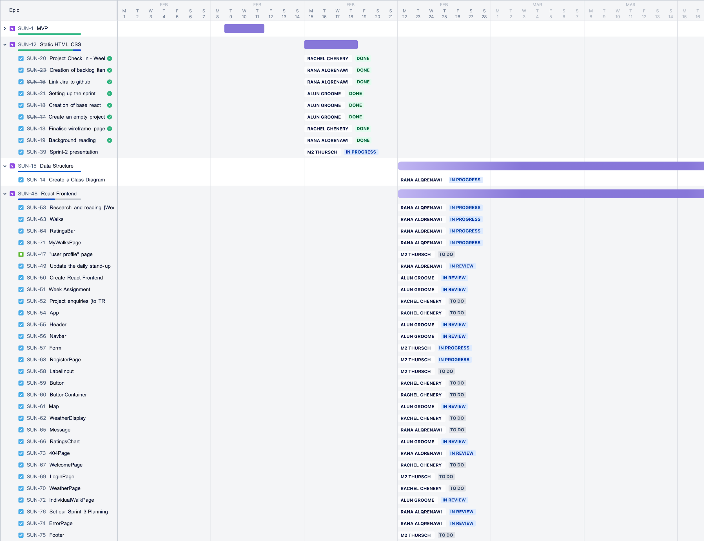
Team Health
and Cohesion
Notes:
Rana

Slide 6
Software Development Tools & Rules
GiHub
Version control code repository
Repository Rules
Change Type Categorization
FEAT: The new feature you're adding to a particular application
FIX: A bug fix
STYLE: Feature and updates related to styling
REFACTOR: Refactoring a specific section of the codebase
TEST: Everything related to testing
DOCS: Everything related to documentation
Branch Creation
Merging Changes to Main Branch
Issue faced in the project
Time
Merge Conflicts
Commit Messages
Little and often
Descriptive
Branch Rules
2 step review and approve
No deletion of branches
Notes:
Alun

Slide 7
Software Development Tools & Rules
Coding Editors and Frameworks
Visual Studio Code
Code formatters
Rules
Format on save
ESLint
Validates code for correctness
Rules
Semicolon
Quotes
Jsx-Quotes
AllowTemplateLiterals
Eliminates code differences
Notes:
Alun

Slide 8
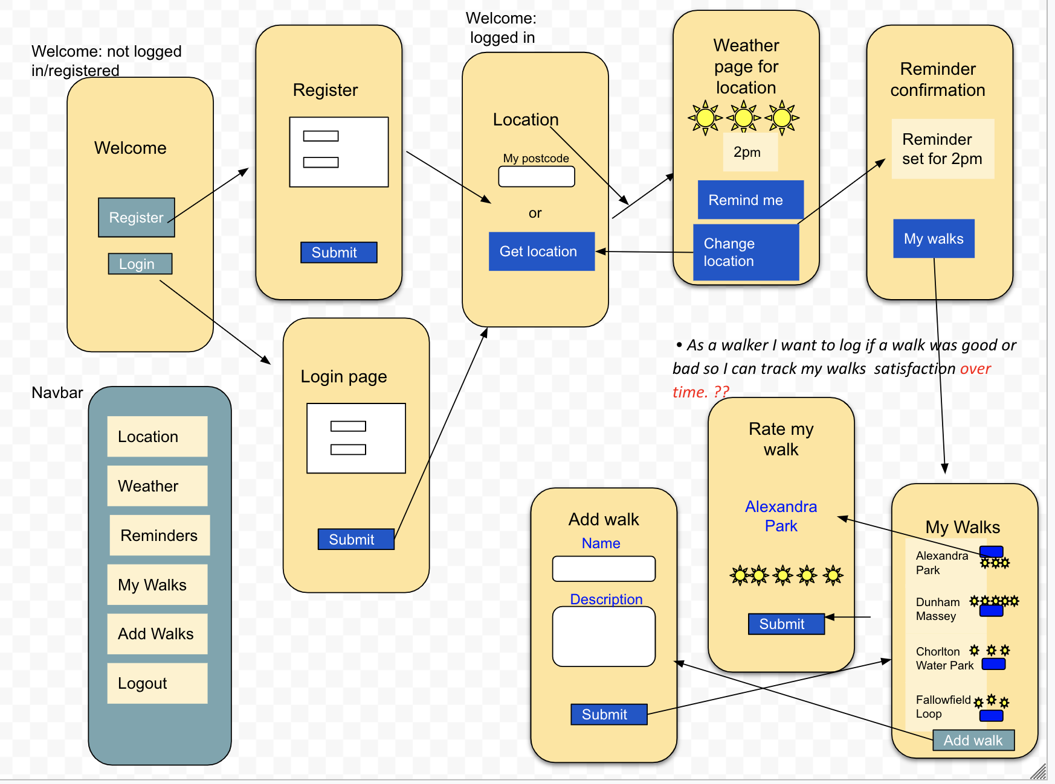
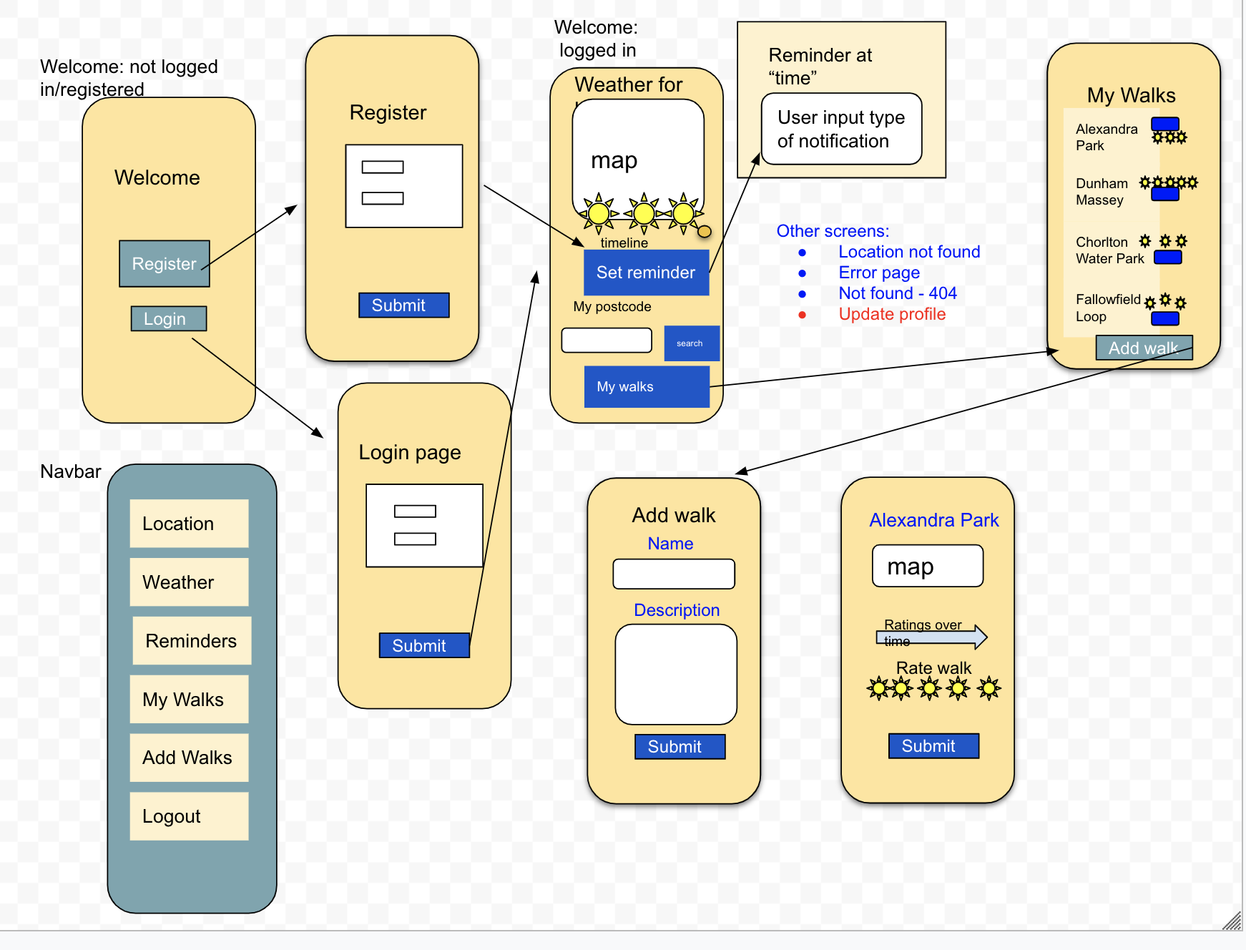
Wireframe
Version 1
Version 2
Notes:
Rachel
At end of last sprint couple of basic wireframes
Next, put the diagrams together to work out the flow of the screens & a rough idea of buttons, etc
The second version is after we looked at the first one and had a discussion, so you can see some of the screens have merged
We are finding it is an ongoing process to refine them

Slide 9
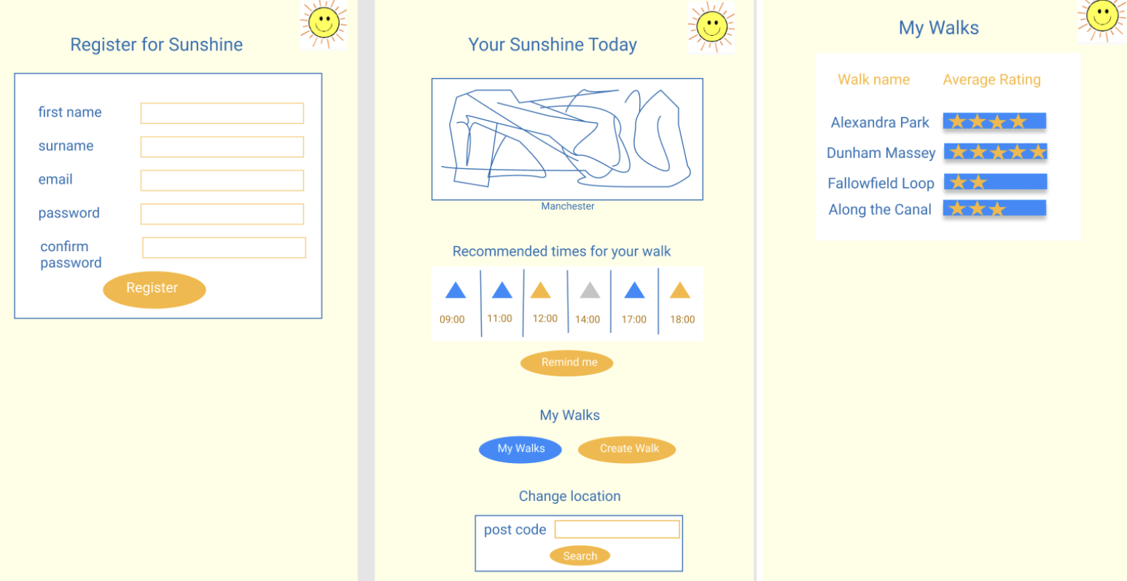
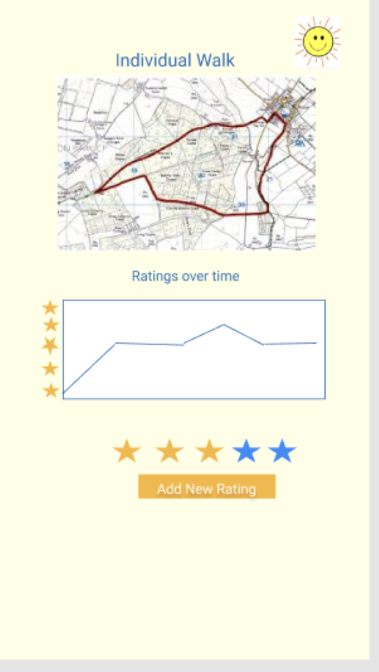
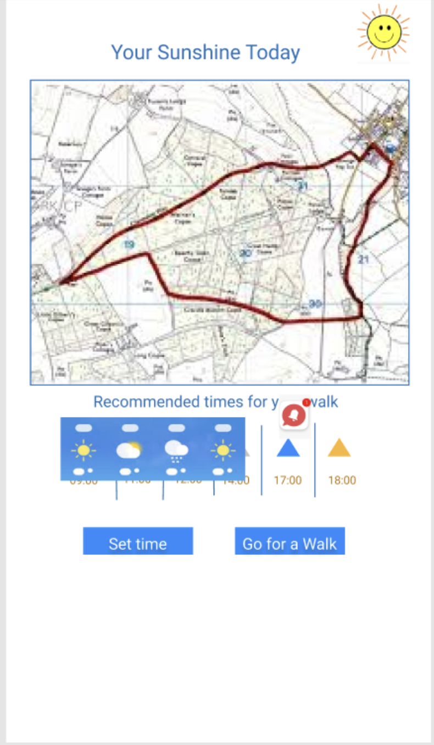
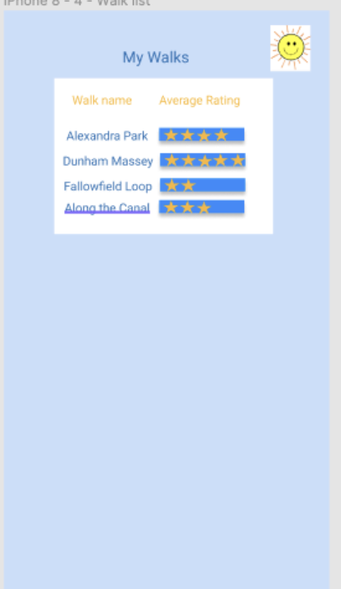
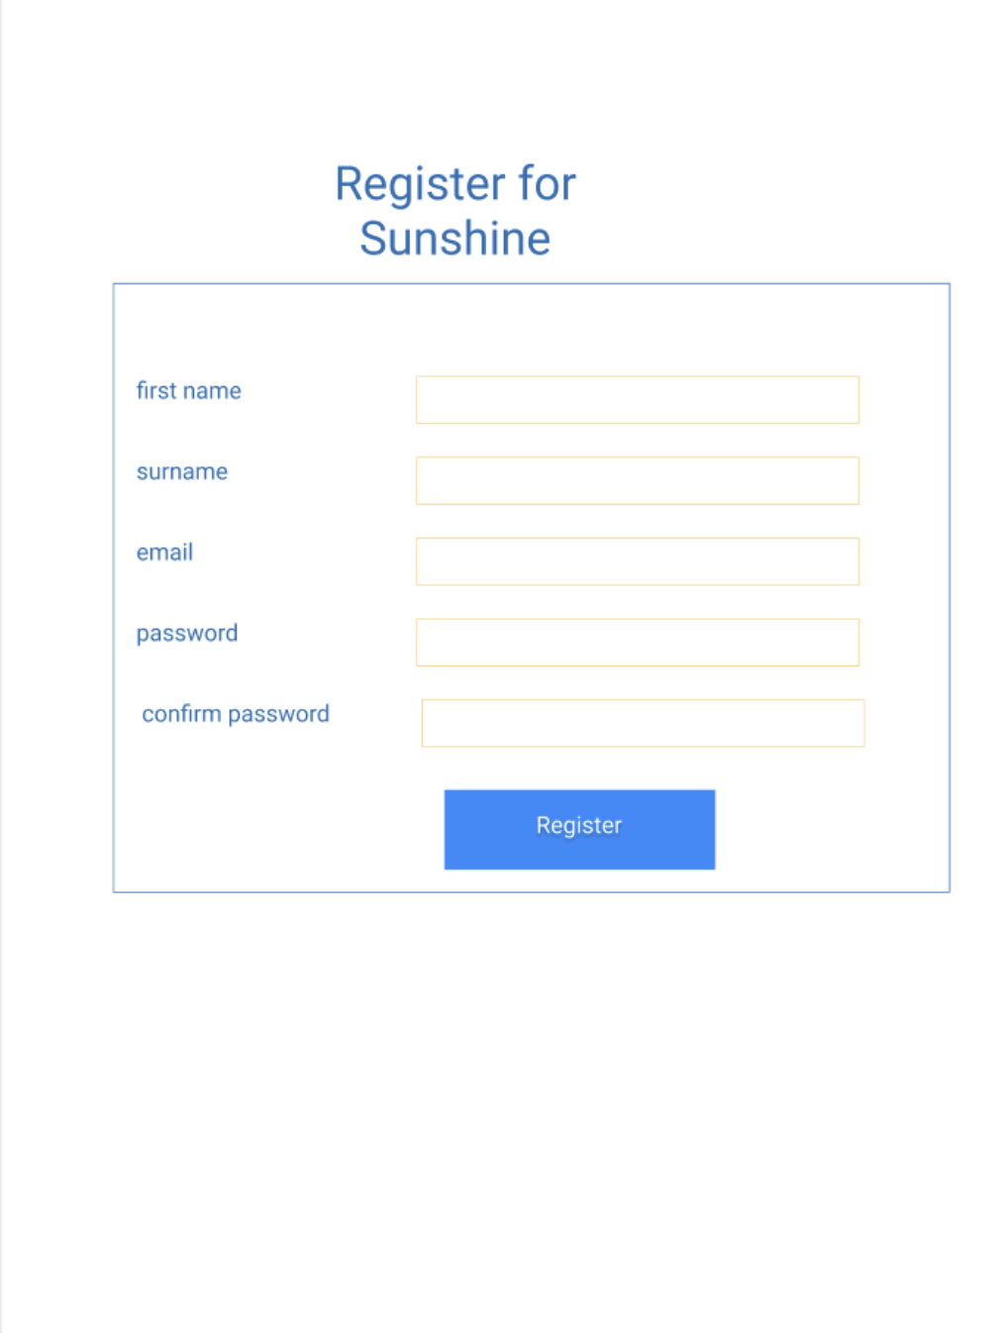
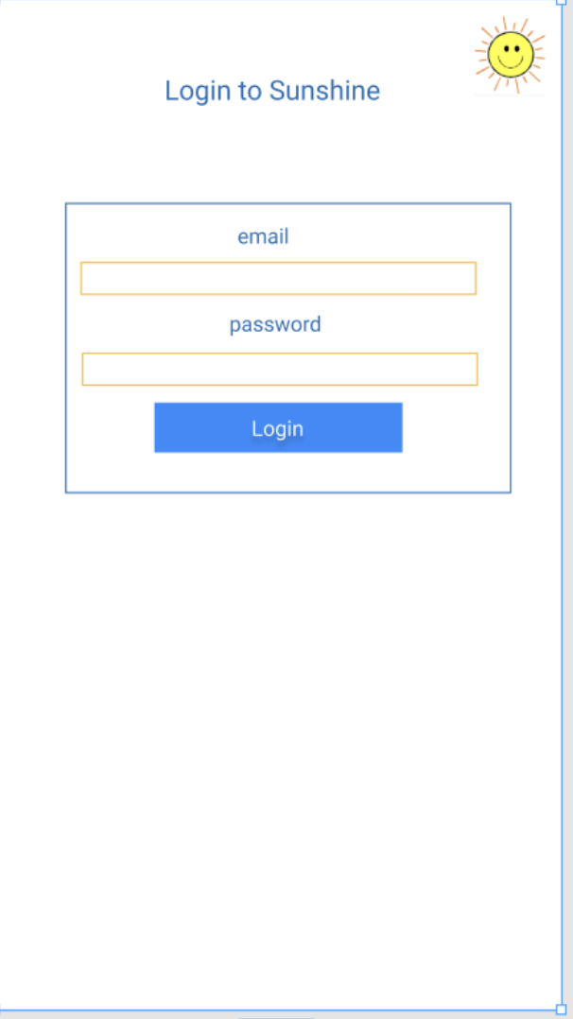
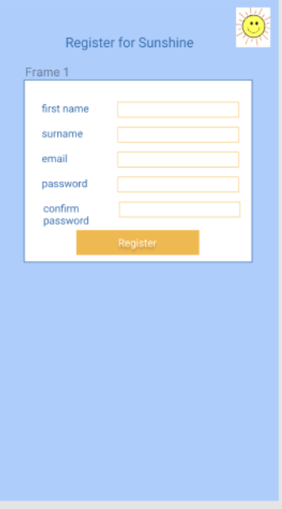
Prototype
Notes:
Rachel
These slides show the progress of our prototype.
We were trying out different colours and progressed towards the simple blue & white for clarity

Slide 10
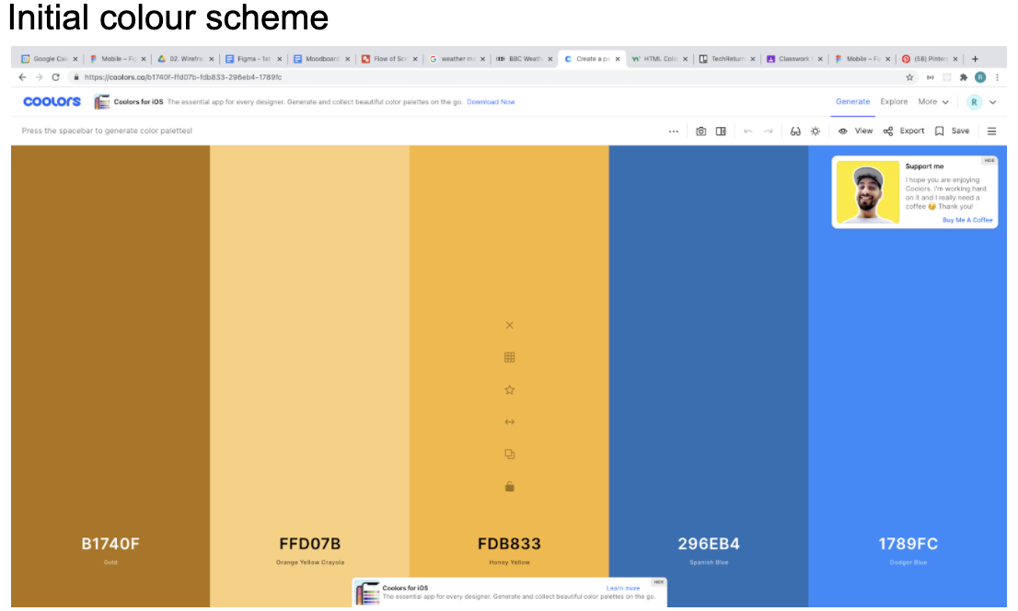
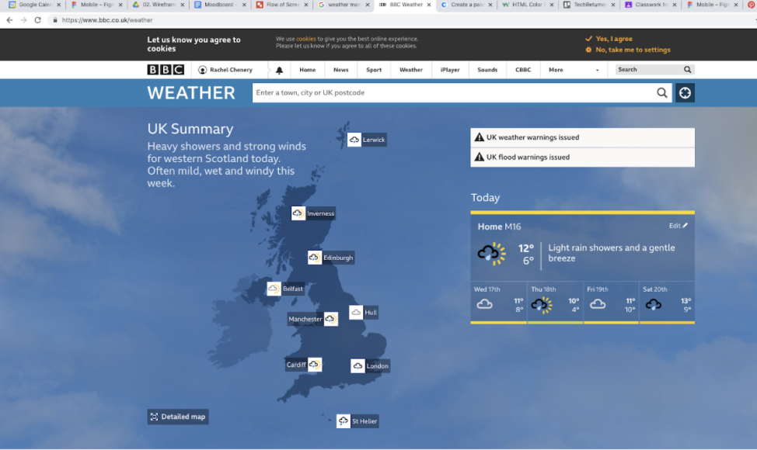
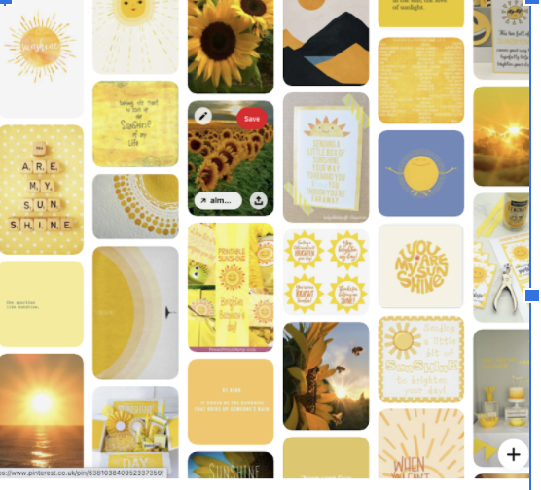
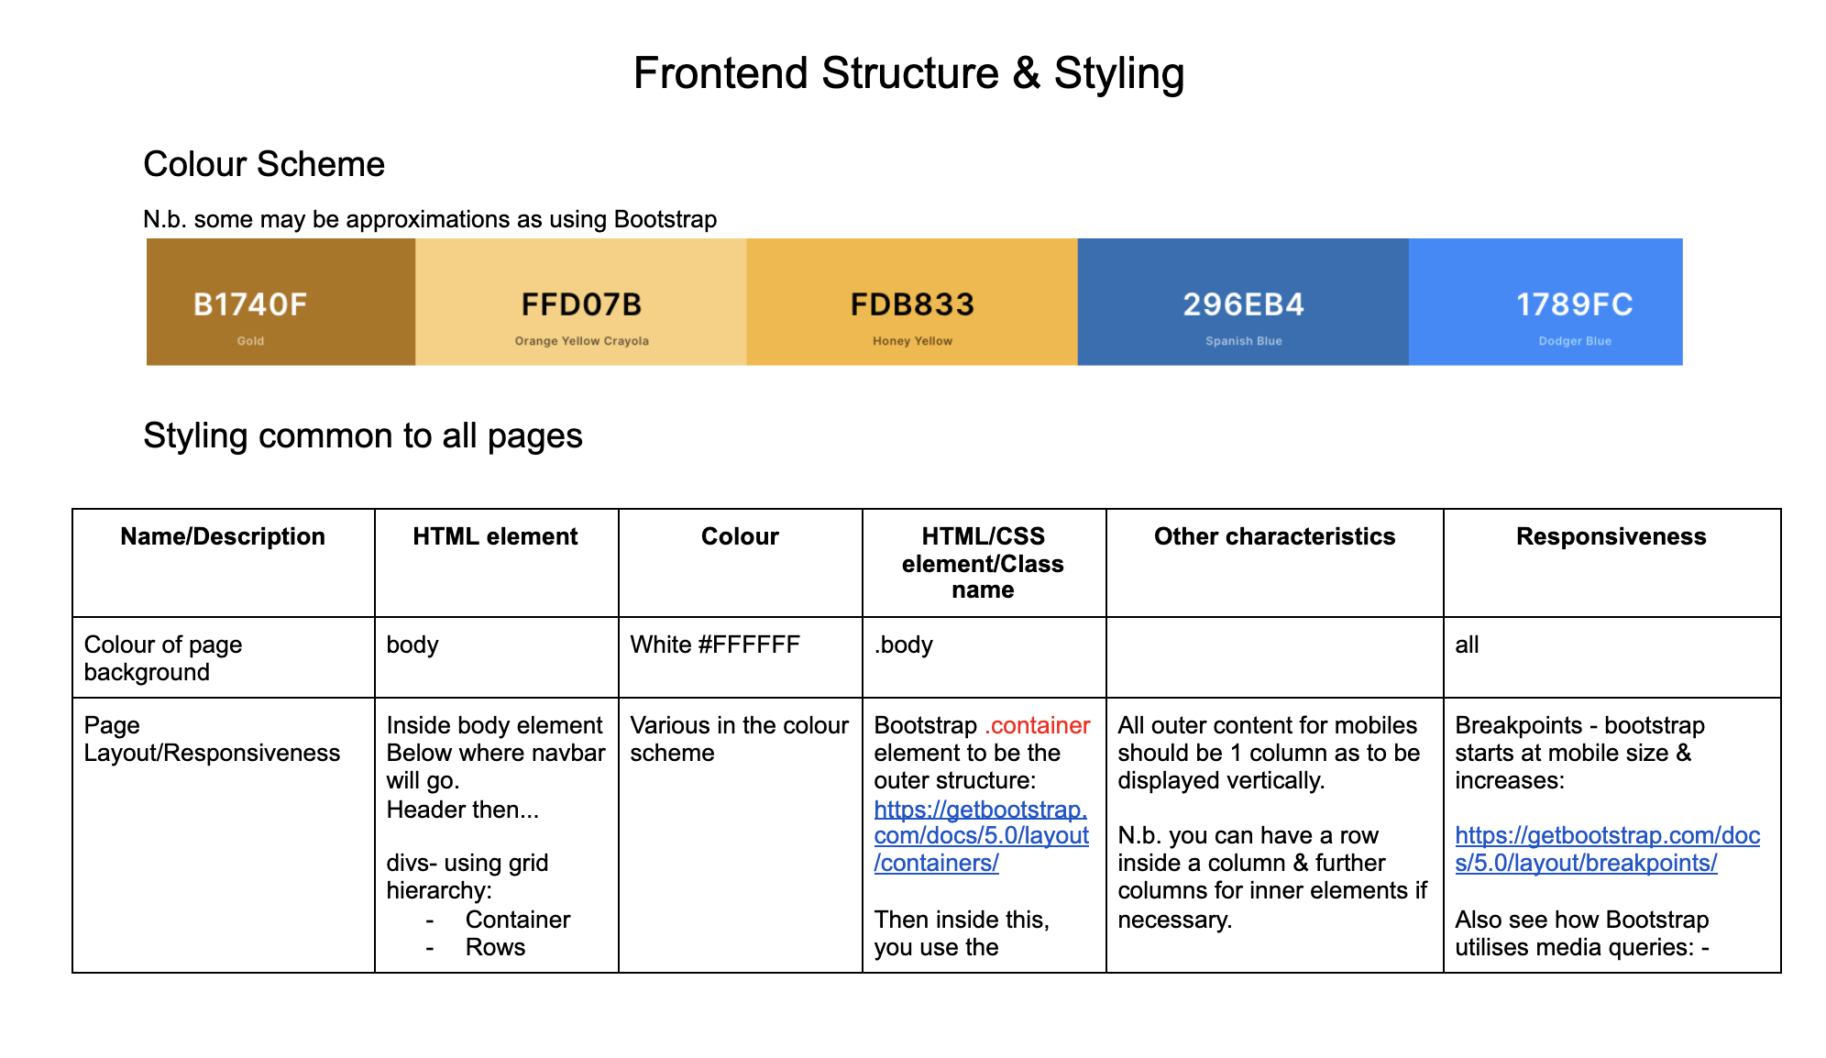
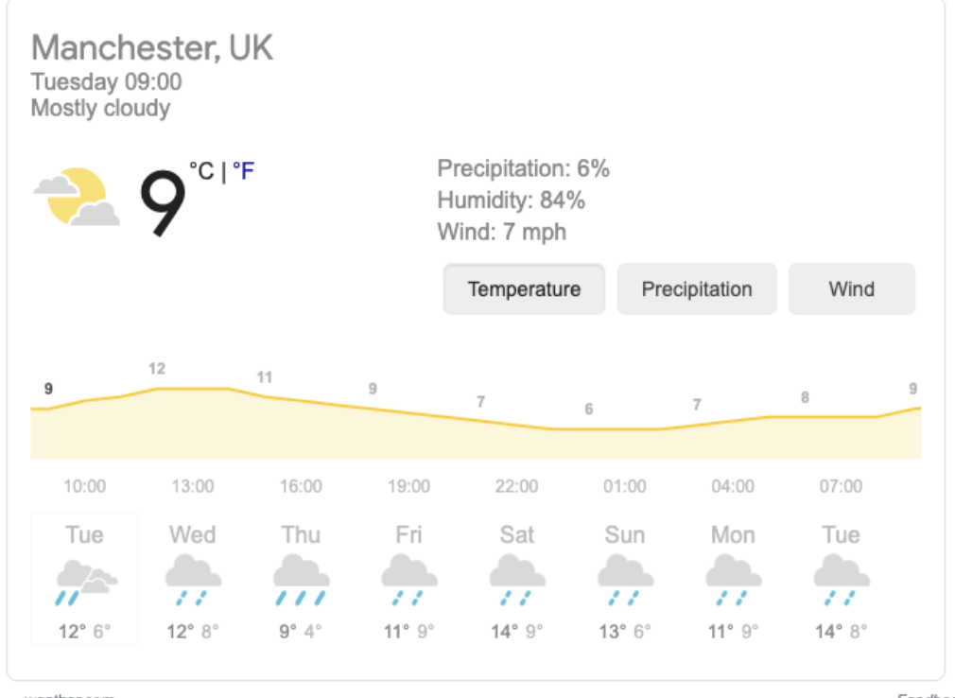
Frontend styling
Notes:
Myriam

Slide 11
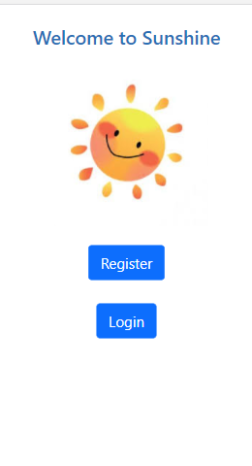
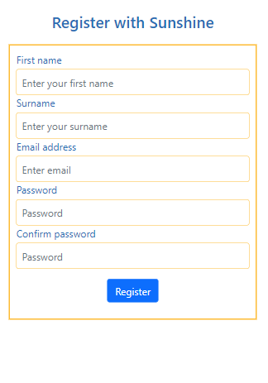
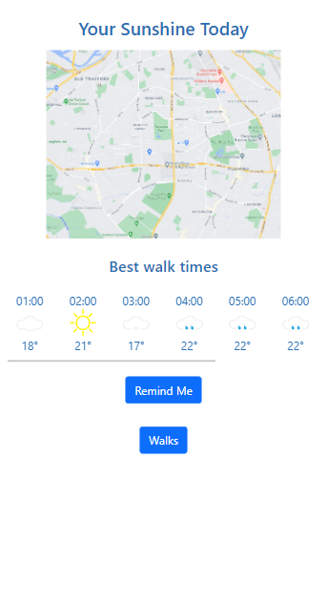
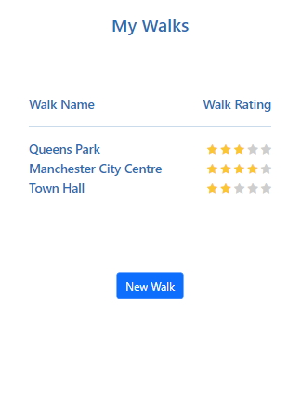
Our static frontend
Notes:
Myriam

Slide 12
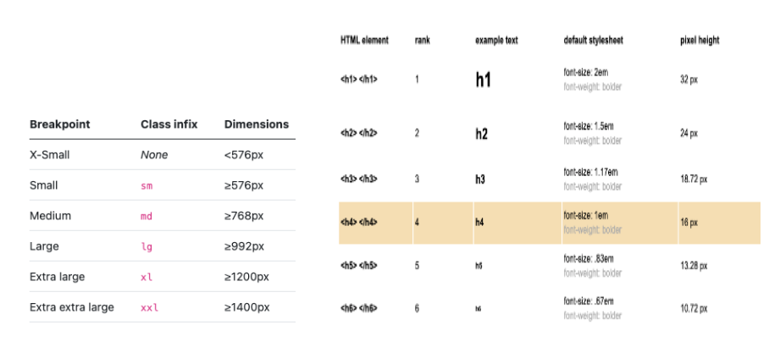
From a static-frontend to a Progressive frontend
Notes:
Myriam

Slide 13
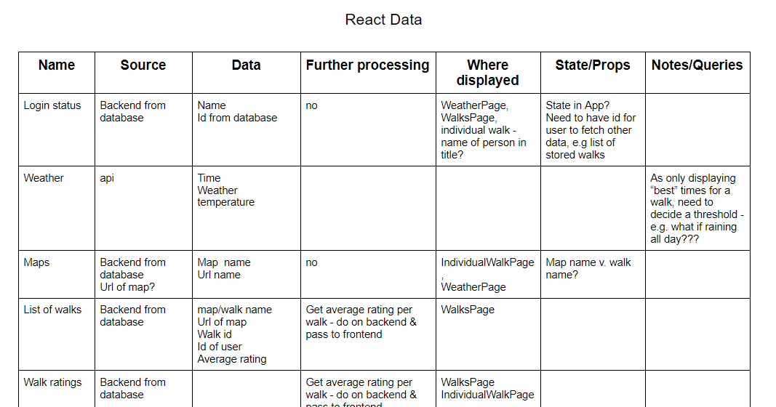
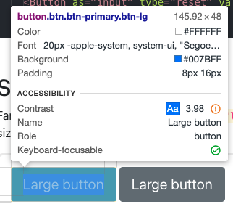
From a static-frontend to a UI
Notes:
Rachel
Moving to React, work out components, some could be common to more than one page
Decided on React bootstrap as a framework as a natural transition from bootstrap static
Also started to work with state and props, using hard-coded data to start
Working on responsiveness & accessibility, e.g. changed color of the buttons to have a higher contrast between text & background

Slide 14
Demo
Notes:
Introduction: Alun
Pages:
Registration/ Welcome Page: Myriam
Weather Page: Rachel
My Walks: Rana
Individual Walk: Alun

Slide 15
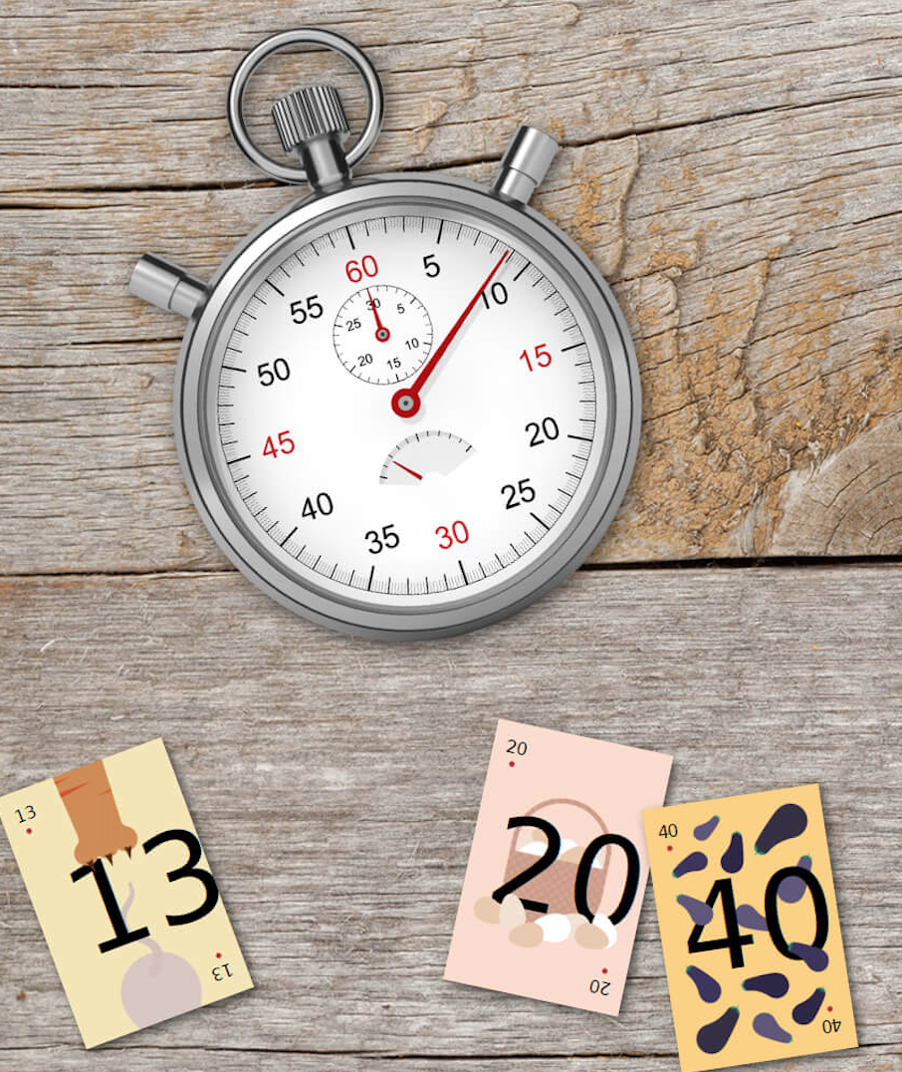
Next Sprint
More Frontend ..?
Data Structure ..
Backend ..
APIs, Security ..?
Online vs Offline ..?
Notes:
Rana

Slide 16

Thanks
for
listening ..
Any
questions?

